Slide 1
High Waters Need Strong Bridges
…
Brooke Anderson
Colorado State University

Slide 3
Galveston, 1900

Slide 4
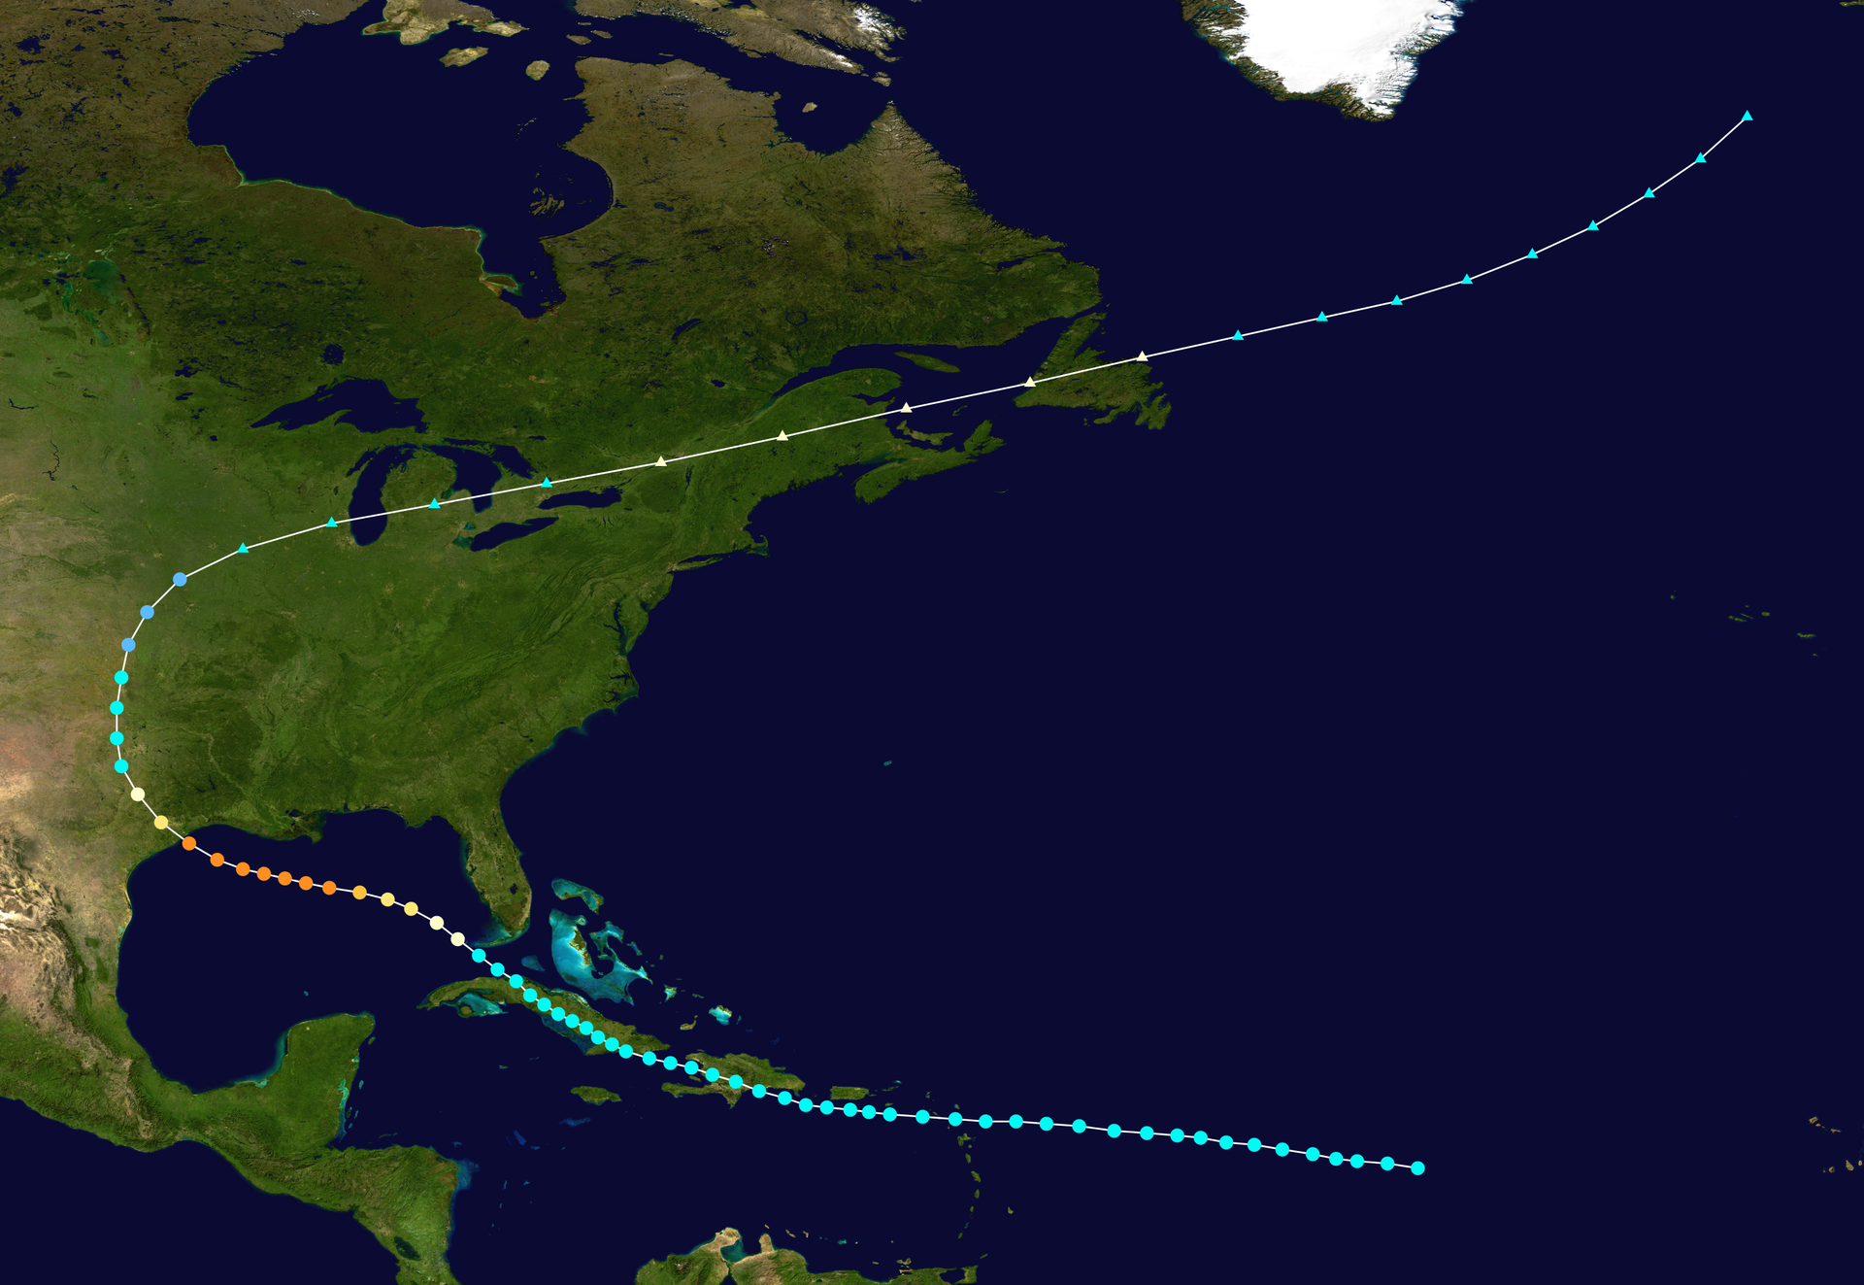

Slide 5
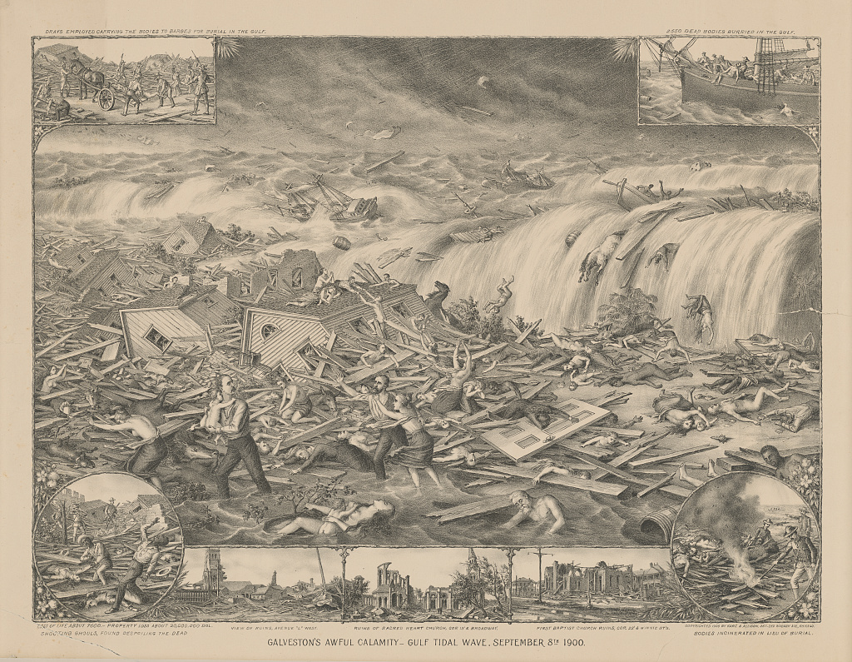
Galveston's awful calamity - Gulf tidal wave, September 8th 1900
Kurz & Allison
”Print shows the destruction caused by a hurricane and tidal wave to Galveston, Texas, wreckage to buildings, survivors, and the bodies of victims; also shows vignettes at the corners and across the bottom: Drays employed carrying the bodies to barges for burial in the Gulf (top left), 2650 dead bodies burried [sic] in the Gulf (top right), Bodies incinerated in lieu of burial (bottom right), Shooting ghouls, found despoiling the dead (bottom left), and at center, View of ruins, Avenue "L" west, Ruins of Sacred Heart Church, cor 13' & Broadway, and First Baptist Church ruins, cor. 22' & Winnie st’s.”

Slide 6
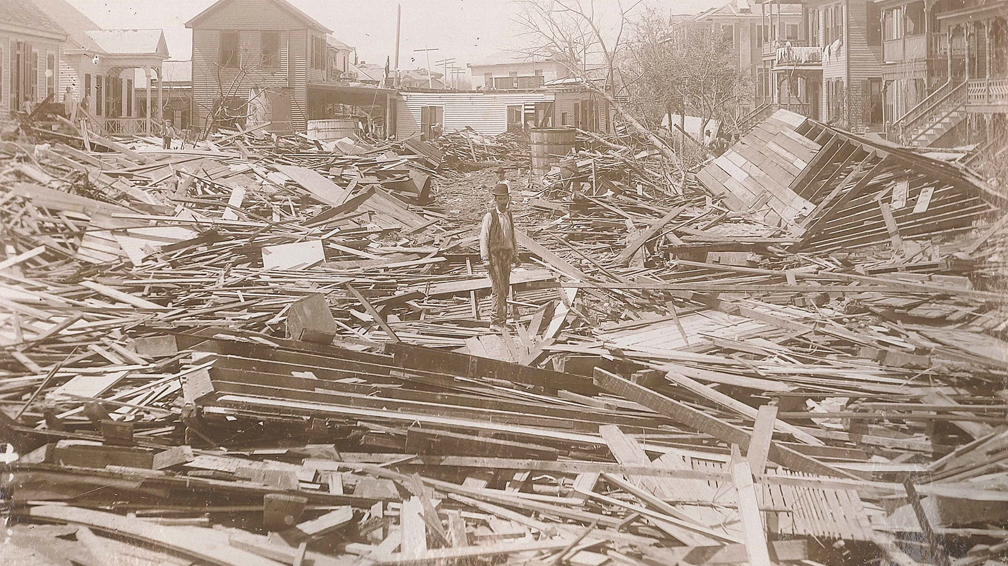

Slide 7
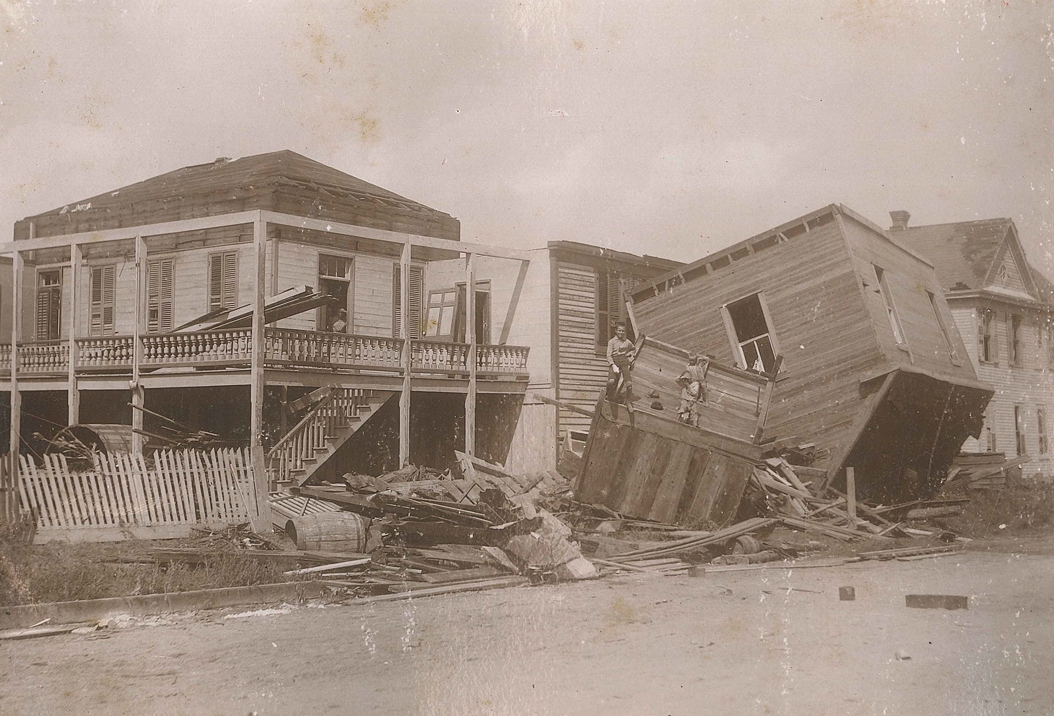

Slide 9
Progress

Slide 10
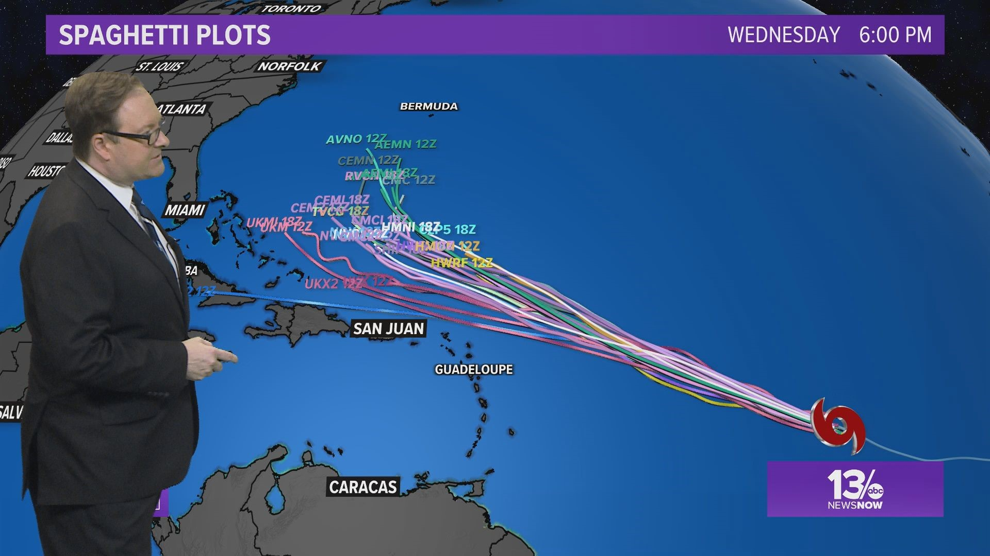
Source: WVEC

Slide 11
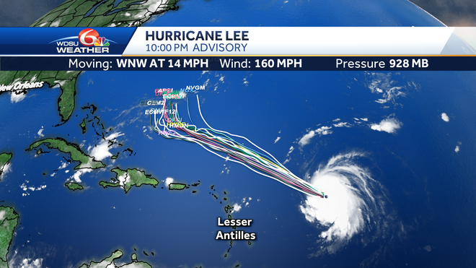
Source: WDSU

Slide 12
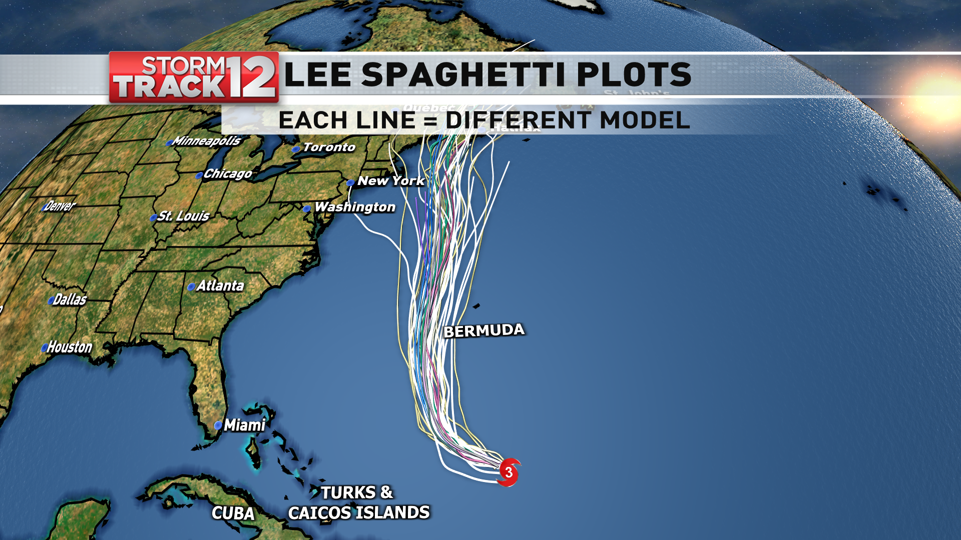
Source: WBNG

Slide 13
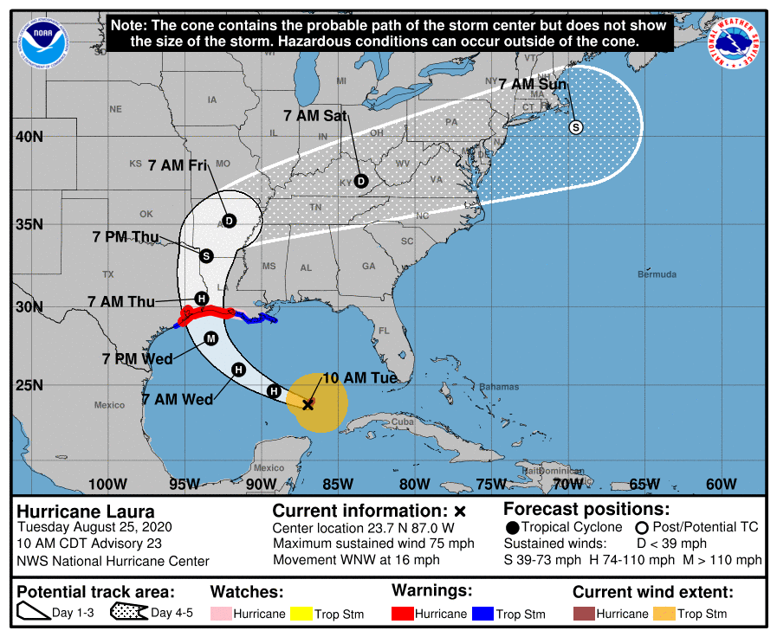
Source: NOAA

Slide 14
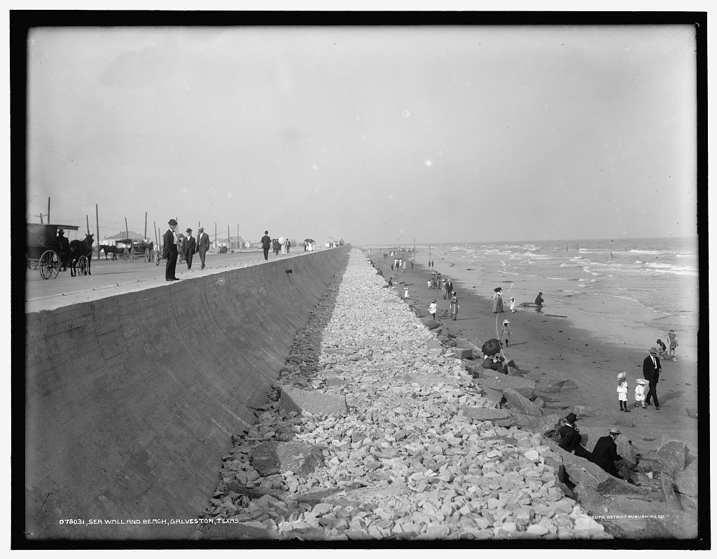

Slide 15
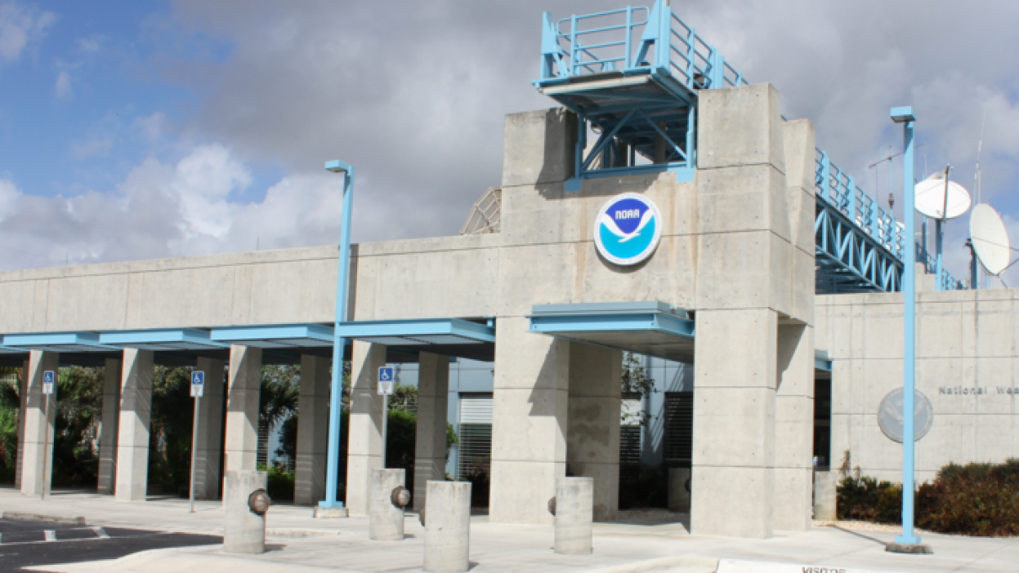
Source: NOAA / NHC

Slide 17
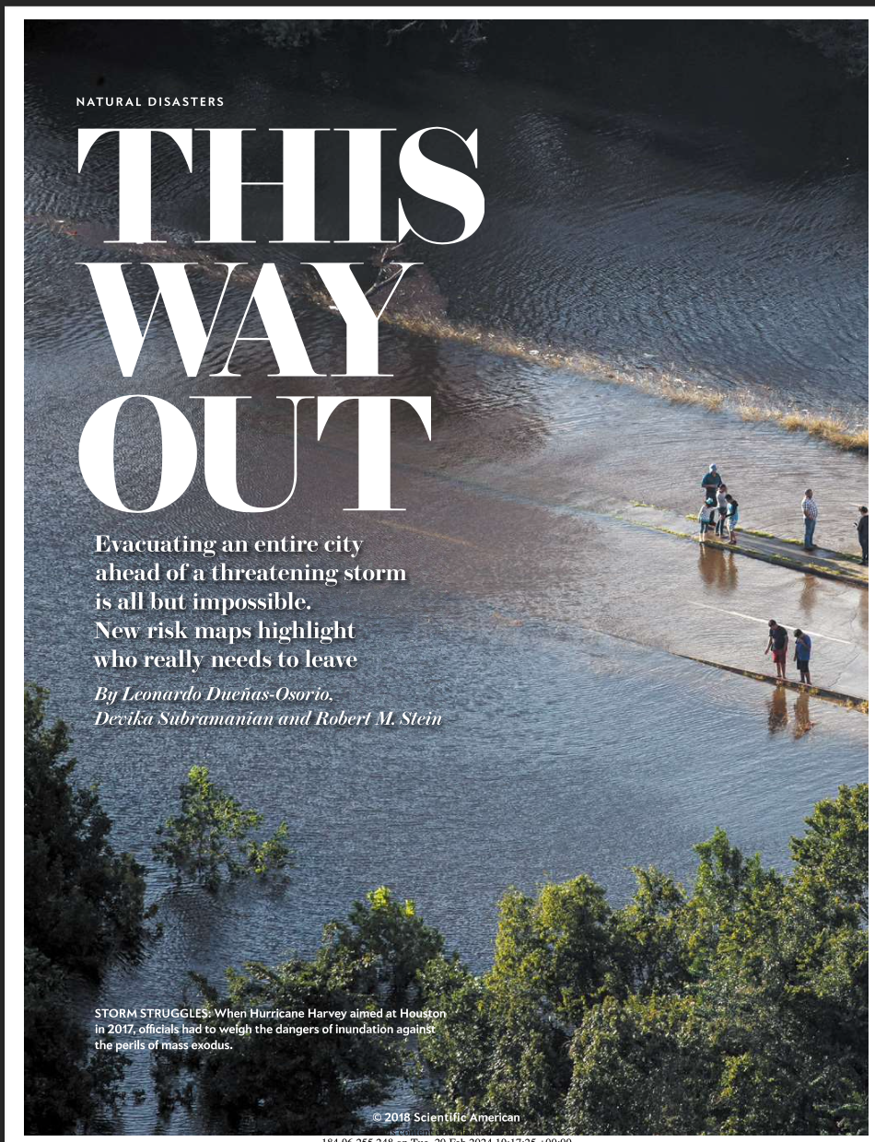
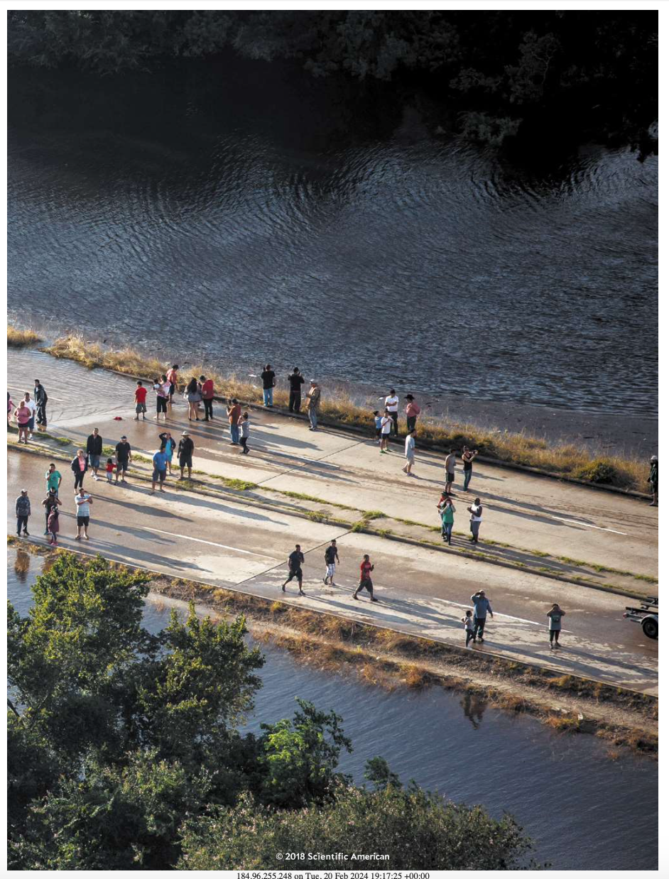
Source: Scientific American

Slide 19
Think in modules and interfaces

Slide 20
Learn the vocabulary

Slide 21
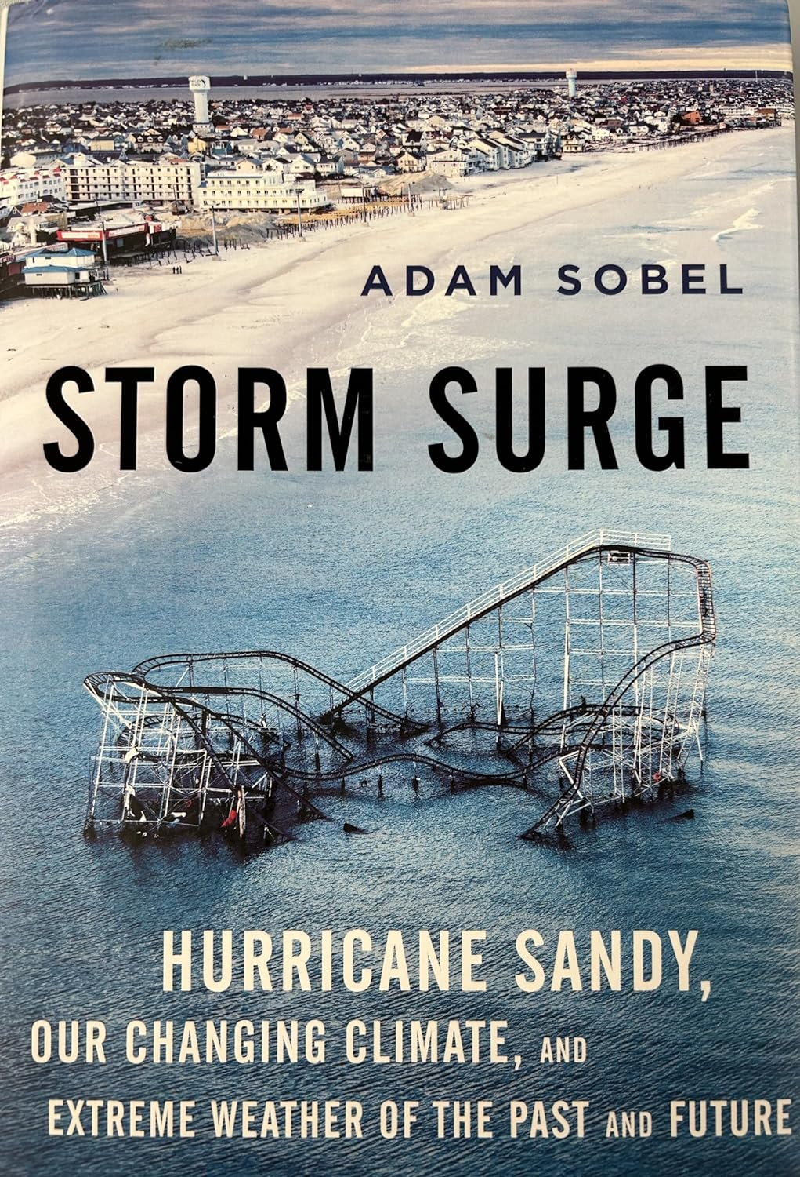
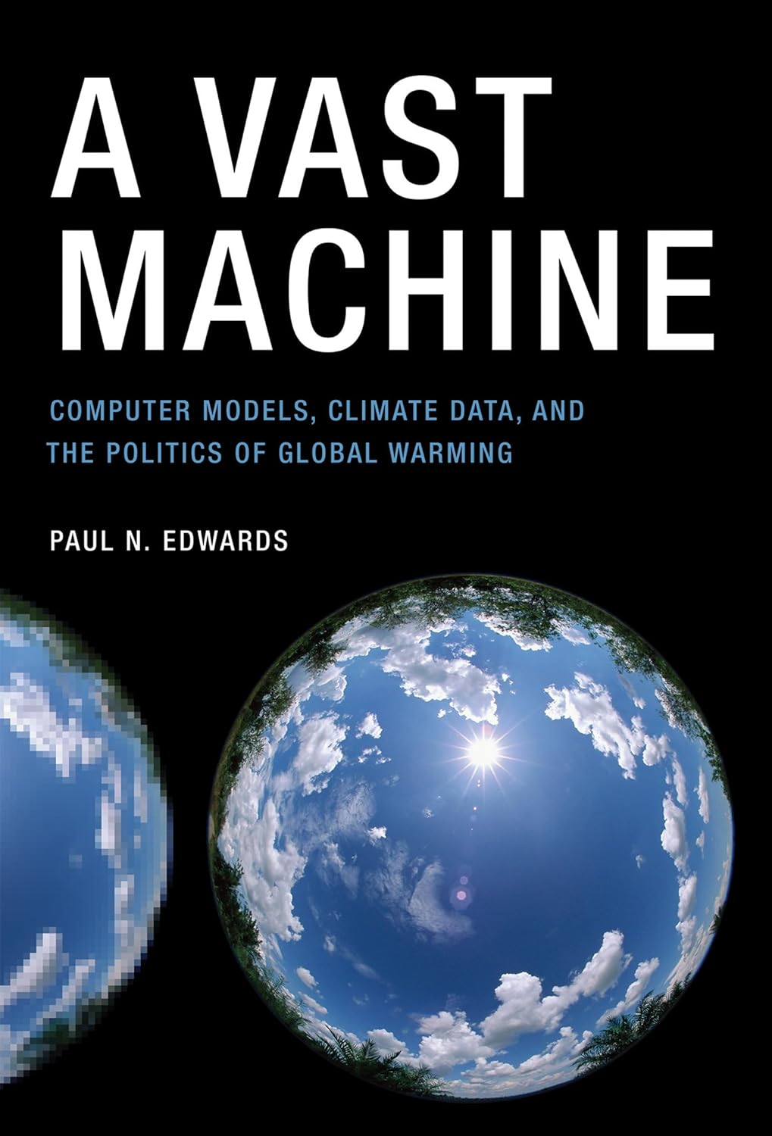
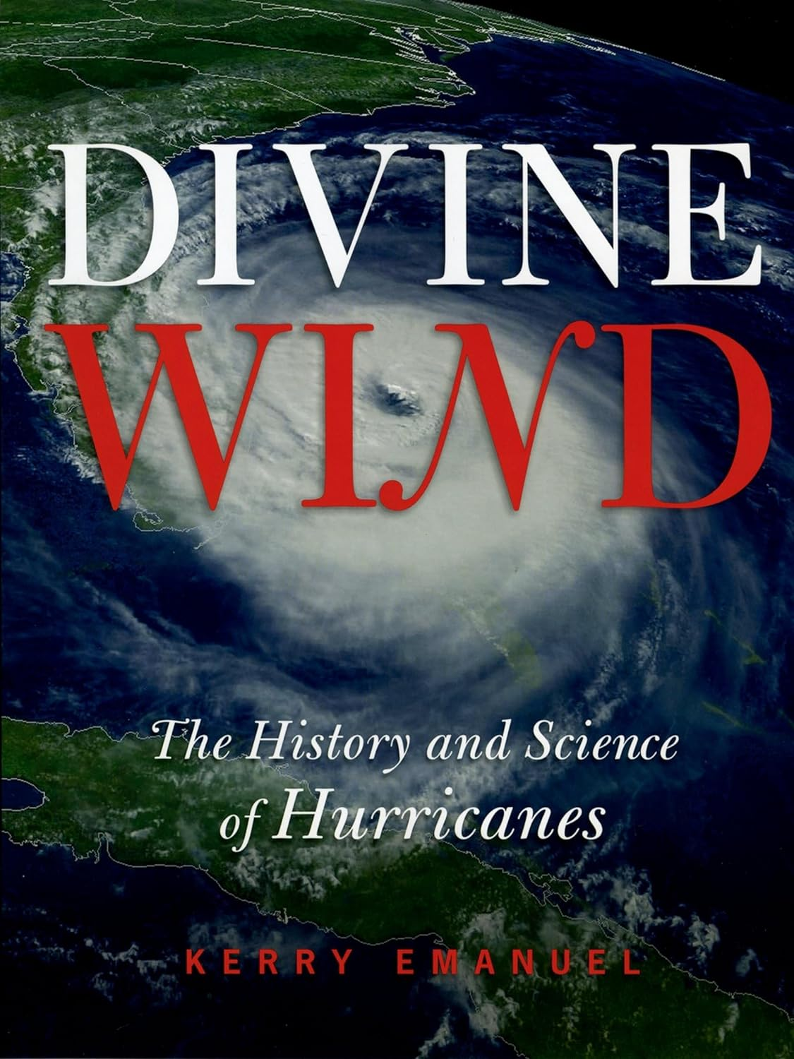
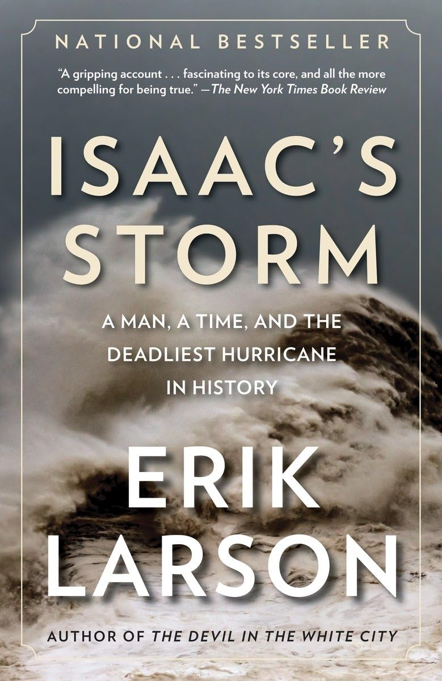
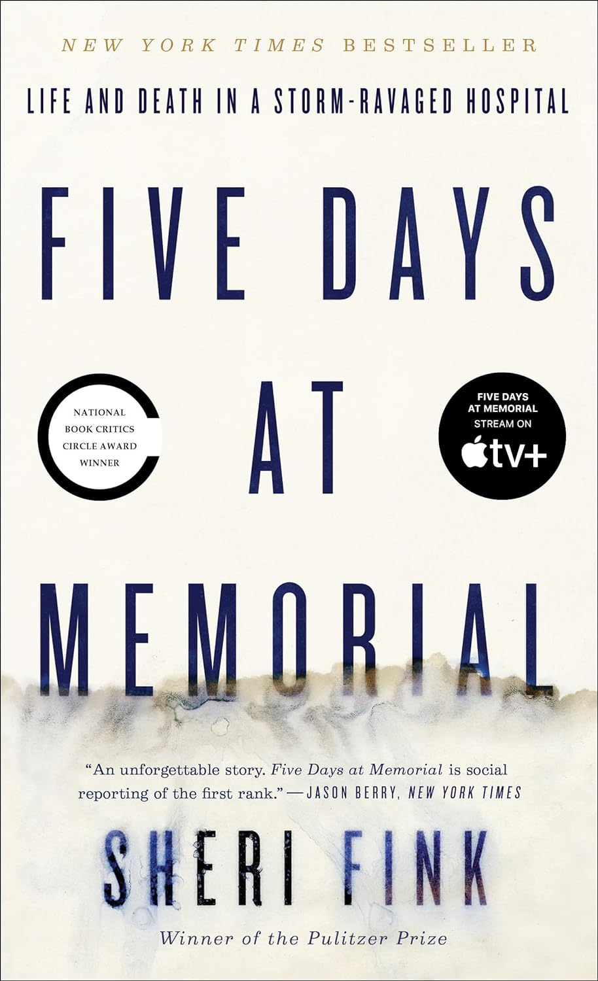
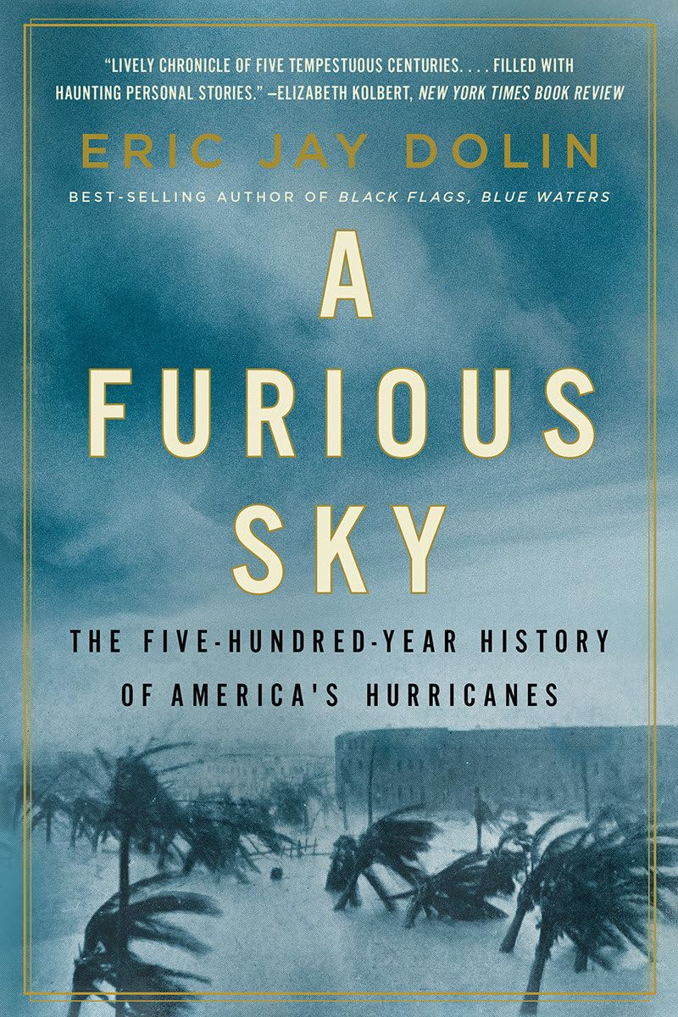
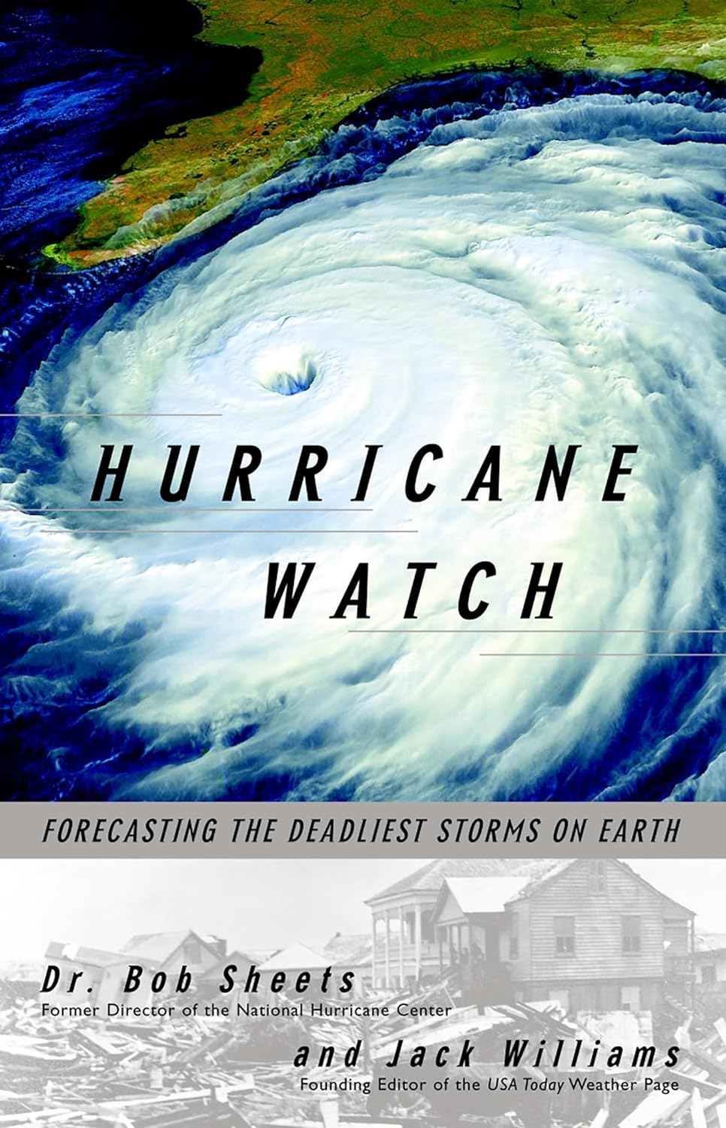
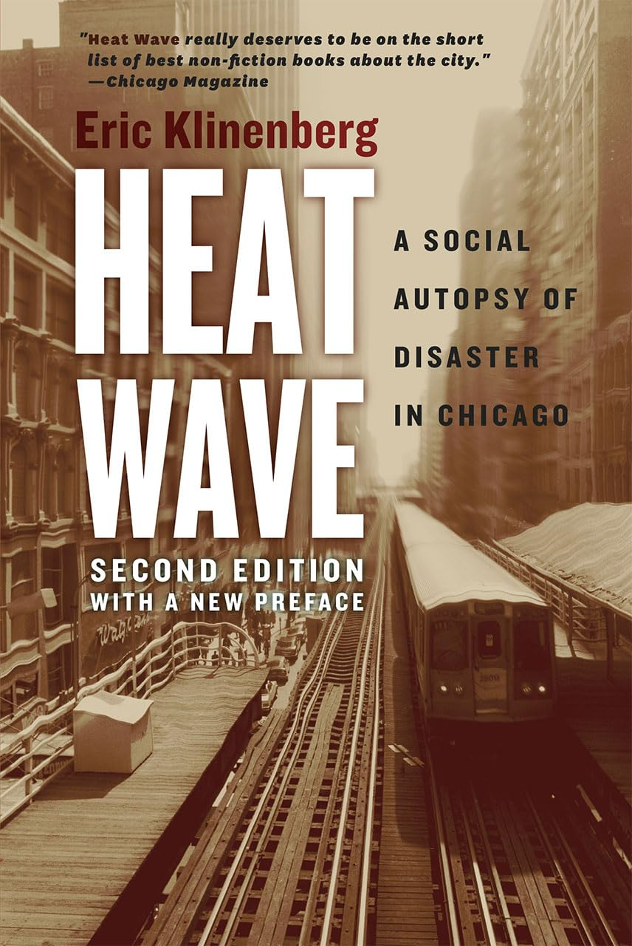

Slide 22
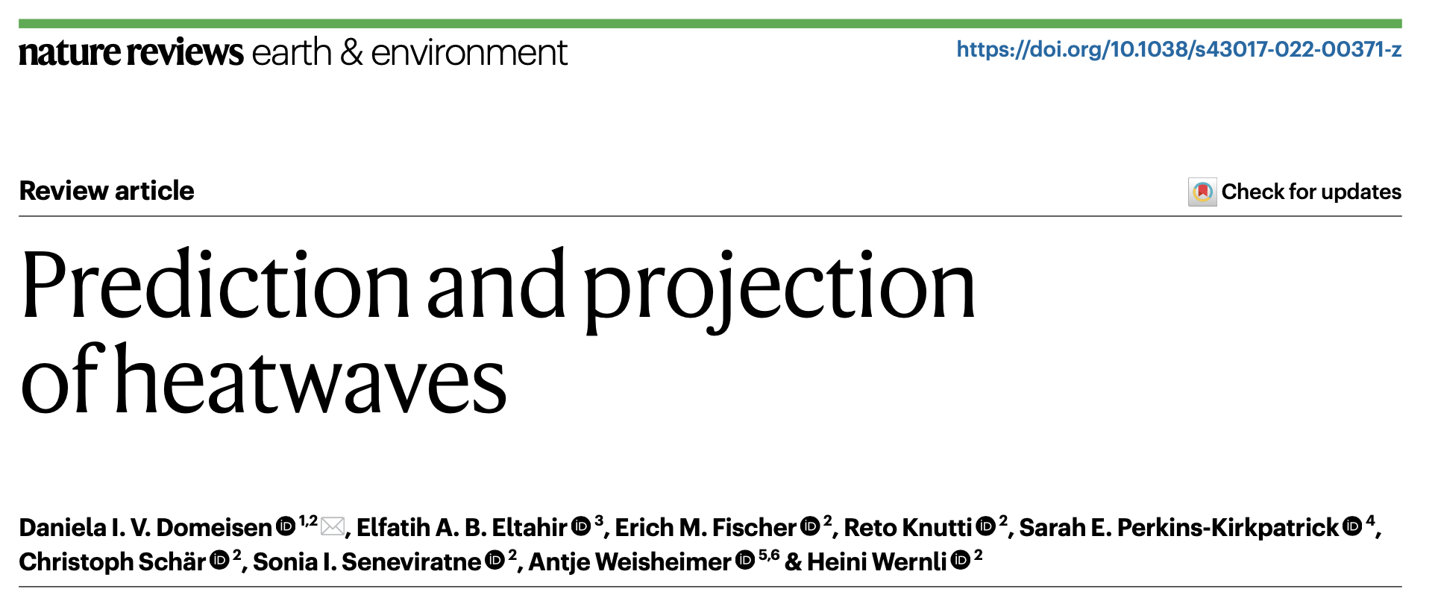
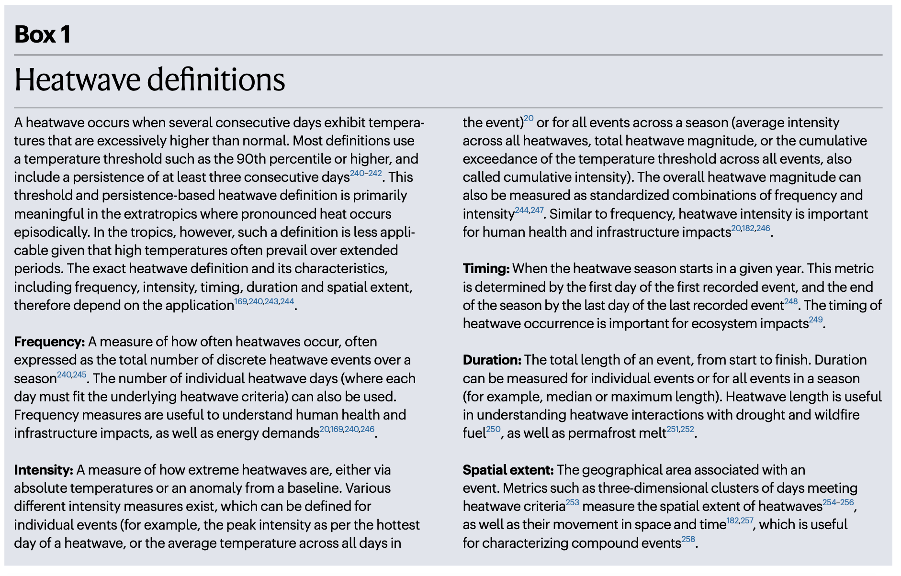

Slide 23
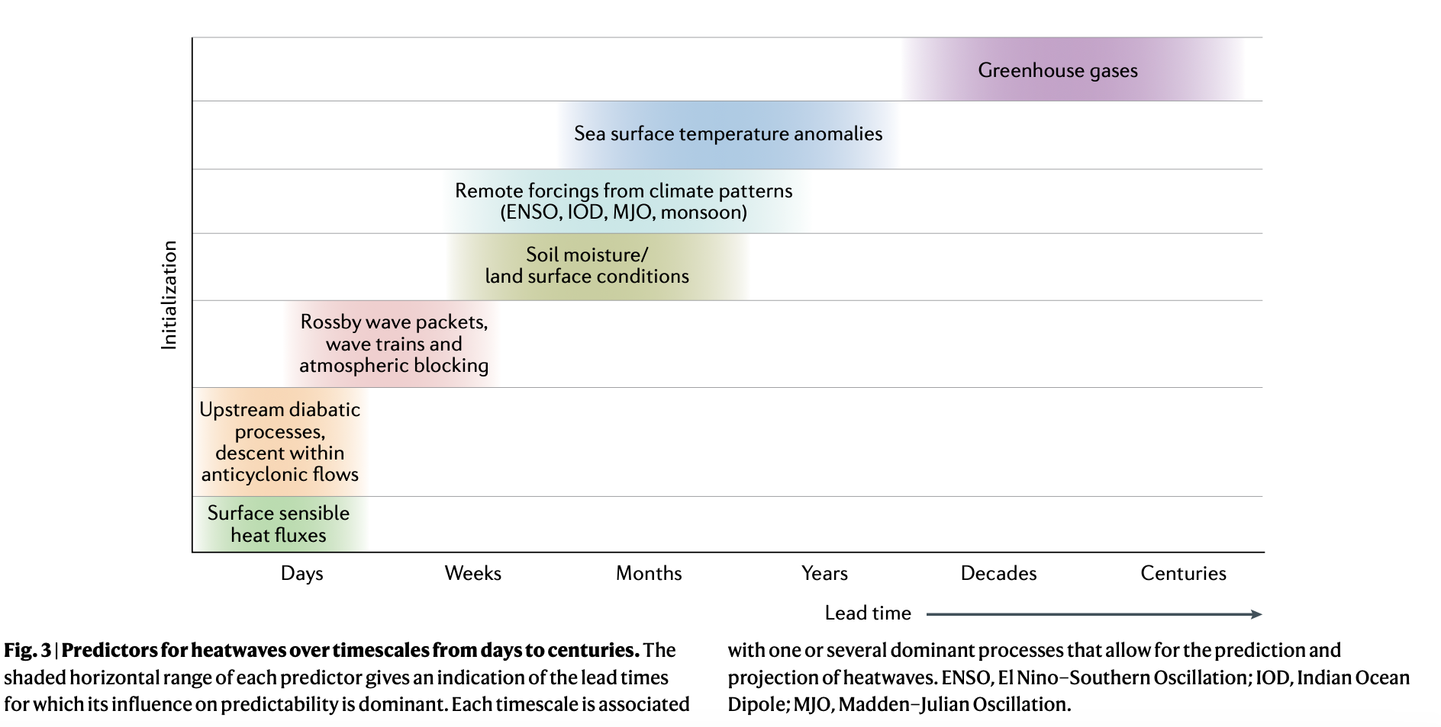

Slide 24
Communicate clearly

Slide 25
